Slide 1
TypeScript
What is it?
How can I use it?

Slide 2
Who knows JavaScript?

Slide 3
Who knows TypeScript?

Slide 4
What is TypeScript?
Superset of JavaScript
Syntax based upon ES6 (ES7 soon)
Adds type notations (optional)
Code-time feedback (via IDE)
Compiles to ES3 ES5

Slide 5
JavaScript is…

Slide 6
1 + 1 = 2

Slide 7

Good JavaScript is…

Slide 8
TypeScript is…

Slide 9


Slide 10

Good TypeScript is…

Slide 11
What can I use?
string
number
boolean
Date
Enum
any
Void
Object
Array
Interface
Inheritance

Slide 12
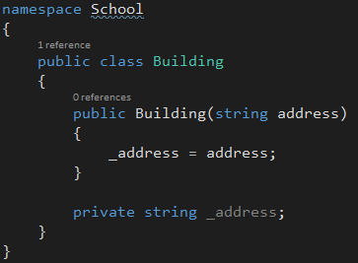
C#

Slide 13
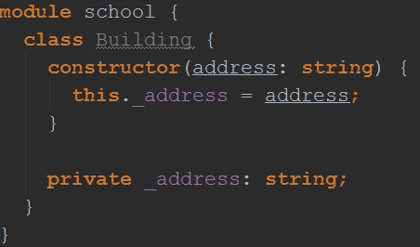
C#
TS

Slide 14
Inheritance…

Slide 15
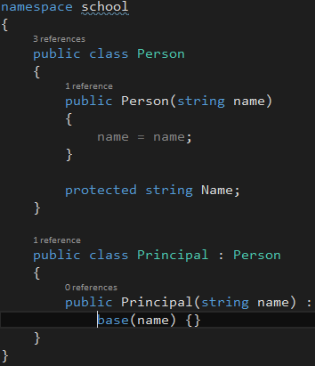
C#

Slide 16
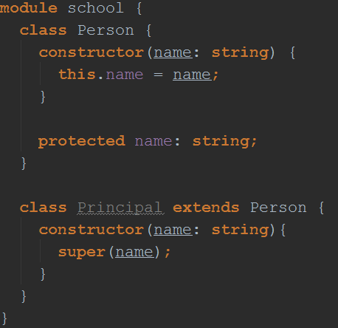
C#
TS

Slide 17
Interfaces...

Slide 18


